Slide 1
New Blades and a Mini Gritter:-
Outcomes of investing in new kit !
Peter Turland
Routine Maintenance Engineer
Doncaster MBC

Slide 2
The Mini Gritter
Background
Requirement to do small areas
Needed to treat
Needed to plough
Needed to be able to carry enough salt
Really needed to be 4 x 4
Usual 7.5T vehicle too large

Slide 3
Looked at various options
4x4 type pickup
Transit size / type vehicle
Could we:-
Convert something from fleet surplus?
Utilise an existing vehicle more effectively?

Slide 4
Vehicle utilisation was the possibly the best way forwards.
This was parked up in the garage most of the winter! and with 4 wheel drive.

Slide 5
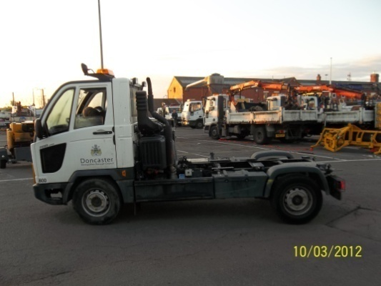
Looked at available options to adapt.
Needed to go through a procurement process.
Set out specification and identified areas of special attention ie:-
Chassis type and body fitting method.
Max. axle and gross weight limits applicable
Operational / spreading controls required.
From the returns, and after evaluation

Slide 6
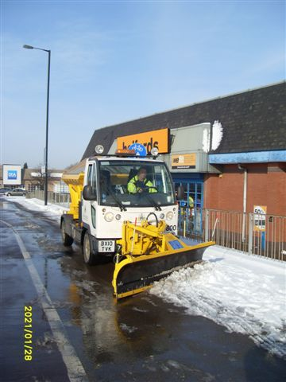
This was created :-
4x4 chassis
Plough with hydraulic angling
2T hopper capacity
Econ Spargo controls with low throw spreader.
LHD !

Slide 7
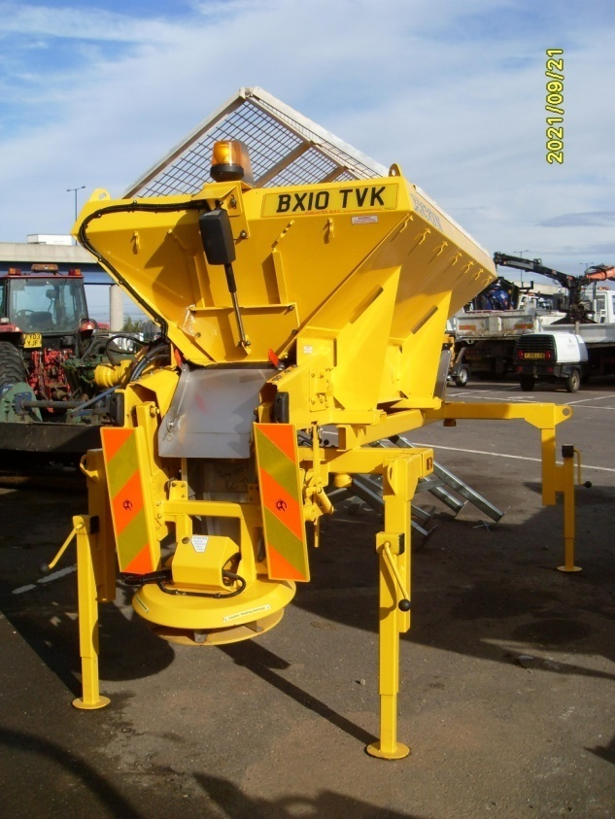
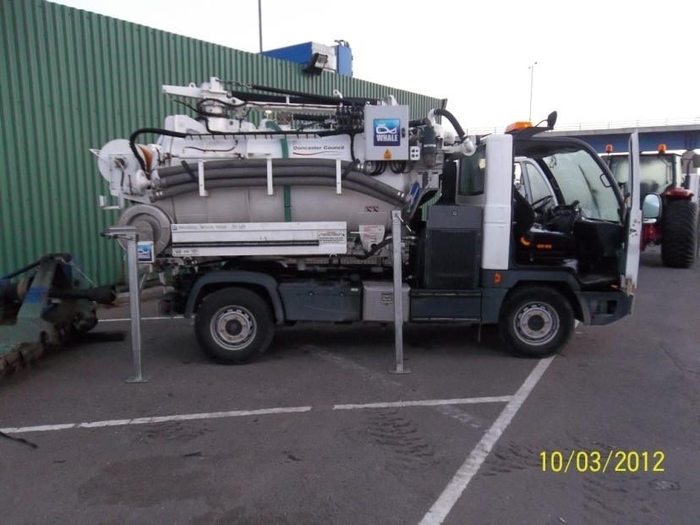
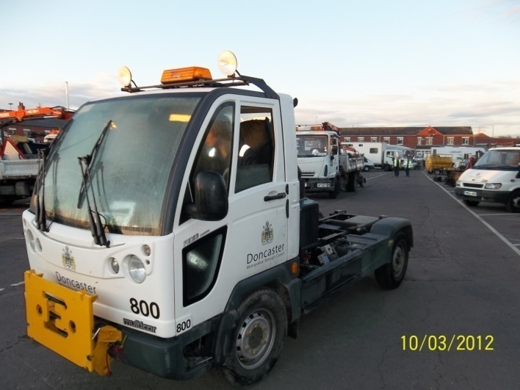
5.5m long + plough
2.0m wide
swop body under 7.5 T

Slide 8
Teething problems:
LHD needed to be got used to.
Some issues with connections but resolving those.
Needed slight modification was required to prevent ingress of salt to engine area between body and cab when loading.
When loading due to size of loader bucket care is needed to avoid salt falling everywhere.

Slide 9
Benefits:-
1. Vehicle now used all year round.
2. Can deal with footway / pedestrian areas,car parks & their ramps.
3. Very manouverable in limited size areas etc.
4. Income earning from work undertaken for other departments.
5. Quick and easy to use as a response vehicle for spot treatments.
6. Enables us to provide a better service,
and much easier than using a shovel !

Slide 10
New blades – well actually, wearing edges.
What were the issues:-
Ploughs being set:-
Leaving too much snow / slush on the road particularly during very low temperatures.
freezing slush problems, and more salt needed
or
When set to clear as close to black as possible.
wearing edge rubbers requiring regular checking and re-setting or replacing.

Slide 11
We looked at the background, the issues, and also recommendations
Previous winters with a lot of snow.
Very low temperatures – anything left on the surface packing readily to ice
Increased salt usage
Reduced salt availability
24hr working, Workshops and fitters busy.
Guidance from UKRLG, HMCoP (H10) & NWSRG

Slide 13
So how did we try and deal with some of these ?
We needed to:-
Ensure as much snow was removed from the surface as possible.
Avoid carriageway surface damage and plough damage.
Minimise down time on ploughs and vehicles
Thereby achieving
Better running surfaces
Potential for reduced salt usage
Better efficiency

Slide 14
So what was required
needed to be:-
Non damaging
Hard wearing / long lasting
Fitted to existing equipment
Fitted in house
Effective in allowing ‘back to black’ ploughing.
We came across this

Slide 15
Rubber faced like the existing ones, but with a ceramic centre core.
These ceramic core units being flexible to allow movement.
The ceramic core being very hard wearing, hence allowing for very near to, or on the surface, running.

Slide 16
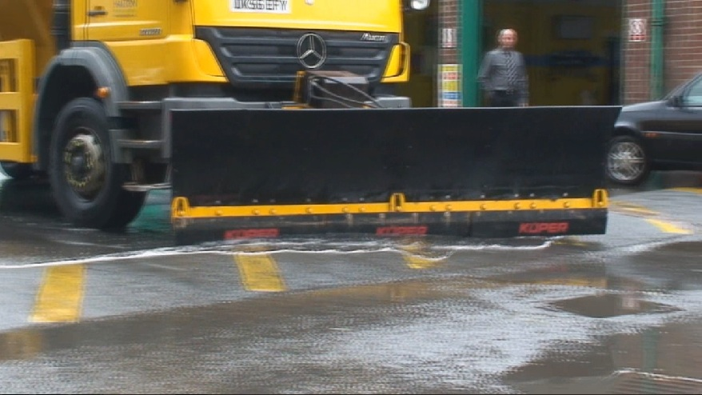
So what did we do ?
We fitted them to two ploughs on specific routes where we could monitor them.
Permanent 9 Cum gritters.
Experienced drivers.
Set them to be at ‘surface level’

Slide 17
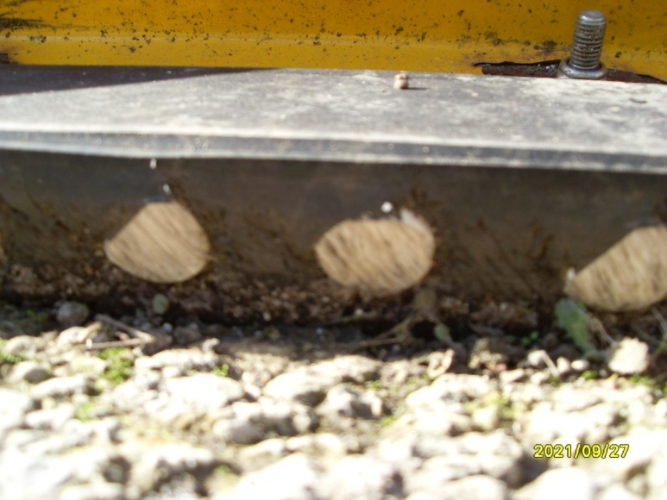
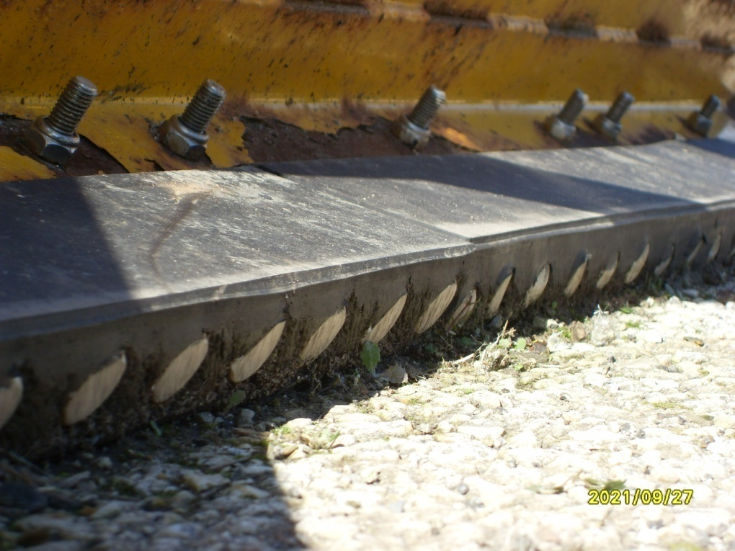
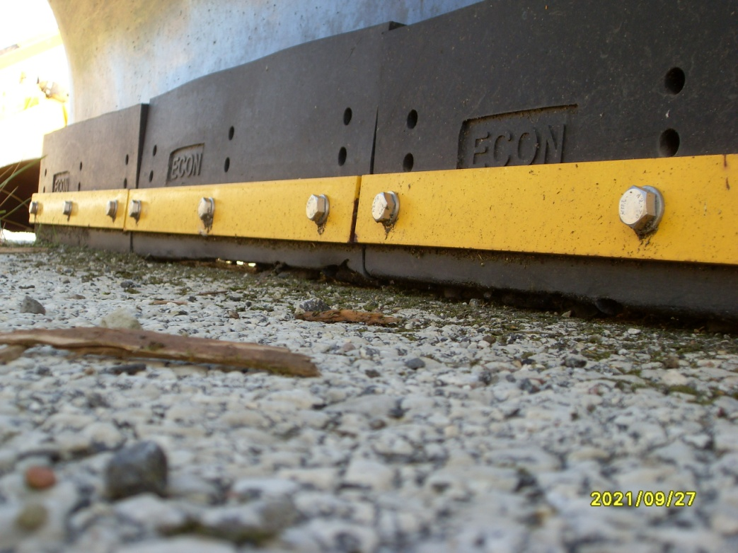
Wear characteristics

Slide 18
To the right you can see the ceramic inners
The core takes the wear.
Issues
To be effective, need to ensure they are set correctly.
Fitters not keen to set ‘lower than before’
Drivers need to be aware of change.

Slide 19
The occasions that we had to use them last winter were limited, however:-
Feedback from drivers using them was good.
To be effective they must be set correctly and that needs highlighting to fitters / drivers / operators.
The signs of wear were very limited – approx 300km covered.
The sections of network on which they were used cleared well and indicated no problems.
Full lifespan has not been determined. I am aware that other authorities like Lincolnshire C.C. have also used some of these units and have had good findings. They certainly appear at this stage to have the necessary characteristics that we were looking for.

Slide 20
Assuming they reach an expected 9 times + longer lifespan as against the previous / existing rubber edges.
The efficiencies in
Vehicles off the road less at critical times
Less time spent changing rubbers
Less work to do when change is needed
Being more effective when in use
Will more than compensate for the extra purchase cost.
Our new machine due this month will be fitted with them and others will be changed in due course.

