Slide 1
Winter maintenance telematics
5th October 2012

Slide 2
About Trackyou
Formed in 2001 by Managing Director Alex Rodda
Specialist full service provider in UK Public Sector with focus on collaborative development
Bespoke winter maintenance solutions designed for the UK Public Sector
Full service provider based in Wrexham and Manchester with national directly employed engineer coverage
Track in excess of 20,000 vehicles across UK
Fleets range in size from 100 to 3000 vehicle’s
Over 400 clients
Company focus is sustainable growth to ensure strong financial background in times of austerity

Slide 3
Awards, accreditations and registrations

Slide 4
Working in partnership
Trackyou work for over 30 Public Sector clients and provide winter maintenance telematics to Local Authorities which include:

Slide 5
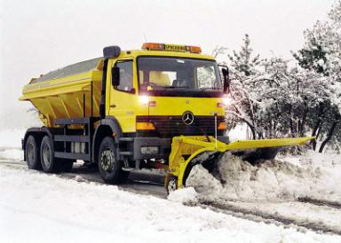
GritMAX
Monitors and reports
Salt Flow
Blast Switch
Spread Width
Spread Rate
Spread Pattern
Control Box
Pre Wet.
Integrates with:
Cuthbertson
Telstar
Econ
Schmidt
Bucher

Slide 6
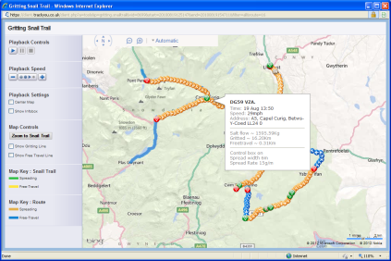
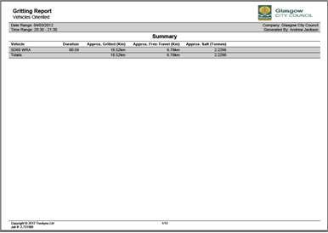
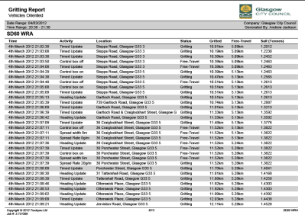
GritMAX
Easy to use, web based system
Data is available in real time – watch the vehicles as they do their work
Extensive data from spreader control unit – all functions are monitored ‘live’
Full reporting available in PDF of Excel
Gritting data can be pushed through API for use on Local Authority websites.

Slide 7
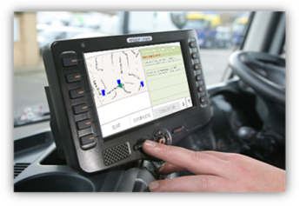
Continuous development
Trackyou are committed to continually improving product range in partnership with our clients.
Latest development:
Location based alerting system
New tablet integration
Driver receives alerts at pre-defined locations
Further development:
- Routing and navigation
- Affordable automated gritting

Slide 8
GritMAX demonstration
Live system demonstration including:
Adding routes
Route playback / snail trail
Deviation and gritting exception alerts
Gritting Reporting
Other system features on request

Slide 9
Thank you
Any Questions?

