Slide 1
Feed-in Tariffs: an update
PRESENTATION PREPARED FOR
Climate Change & Renewables
Working Group
PREPARED BY
ADAM DAVIDSON
WALKER MORRIS
26 SEPTEMBER 2012

Slide 2
What are Feed-in Tariffs?
Introduced in 2010
Two parts: generation and export
Wind, solar, anaerobic digestion, hydro and micro CHP
Up to 5MW capacity
Banded
Fixed on eligibility date (subject to RPI)
MCS and ROO-FIT

Slide 3
Recent changes - solar
Changes effective 3 March, 1 April and 1 August 2012
Lower generation tariffs
Increased export tariff
Reduced tariff lifetime
Link to energy efficiency
Multi-installations/aggregation
Degression from 1 November 2012
Preliminary accreditation

Slide 4
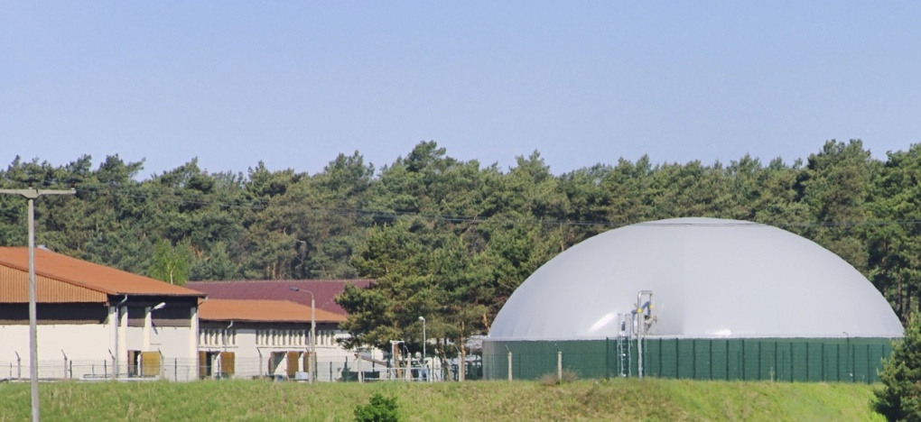
Recent changes – others
Changes effective 1 December 2012
Lower generation tariffs
Increased export tariff
Preliminary accreditation
Definition of community energy project
Degression from 1 April 2014

Slide 5
Impact on projects
Projects already accredited
Proposed projects
Impact between now and 1 December 2012
Using pre-accreditation

Slide 6
Conclusion
FITs-based projects still represent good value
Need to act quickly to avoid degression and maximise income
Use pre-accreditation to give some certainty

Slide 7
Questions
Adam Davidson
Director
Walker Morris
Kings Court, 12 King St, Leeds LS1 2HL
T: +44 (0)113 283 4477
M: +44 (0)7764 692338
E: adam.davidson@walkermorris.co.uk
W: www.walkermorris.co.uk
Twitter: @adamadavidson

